Slide 1
LOGISTIC REGRESSION

Slide 2
1. What is Logistic Regression
Logistic Regression is a supervised machine learning algorithm and a statistical classification method used to predict the probability of a categorical outcome, most commonly binary outcomes (0 or 1, Yes or No).
Despite the name, it is used for classification, not regression.

Slide 3
2. Purpose of Logistic Regression
The purpose of Logistic Regression is to:
Predict the probability of an event occurring
Classify data into discrete categories, especially binary classes (0 or 1)
Model the relationship between features and log-odds of an outcome
Support decision-making using probability thresholds
Provide interpretable classification results
In simple terms: Logistic Regression is used when the output is categorical and decisions are made based on probabilities.

Slide 4
3. Why it is Used
Logistic Regression is used because it:
Predicts probabilities
Performs binary and multiclass classification
Is simple, fast, and interpretable
Works well when the relationship between features and log-odds is linear
Provides clear decision boundaries

Slide 5
4. How Logistic Regression Works
Takes input features X
Computes a linear combination of inputs
Applies the sigmoid (logistic) function
Converts output into a probability (0 to 1)
Uses a threshold (e.g., 0.5) to assign class labels

Slide 6
5. Where it is Used
Logistic Regression is used in:
Machine Learning
Data Science
Healthcare analytics
Finance & banking
Marketing analytics
Social science research

Slide 7
6. Formula
Linear Combination:
z = β0+β1x1+β2x2+⋯+βnxn
Sigmoid Function:
σ(z) = 1/1+e^−z
Logistic Regression Model:
P(y=1∣X) = 1/1+e^− (β0+β1x1+⋯+βnxn)

Slide 8
7. Technical Details
Types:
Binary Logistic Regression
Multinomial Logistic Regression
Ordinal Logistic Regression
Assumptions:
Binary dependent variable
Independent observations
Little or no multicollinearity
Linear relationship between predictors and log-odds
Large sample size preferred
Cost Function (Log Loss / Binary Cross-Entropy):
J(θ)=−1/n∑i=1n[yilog⁡(y^i)+(1−yi)log⁡(1−y^i)]
Optimization:
Gradient Descent
Maximum Likelihood Estimation (MLE)
Evaluation Metrics:
Accuracy
Precision, Recall
F1-Score
ROC-AUC
Confusion Matrix

Slide 9
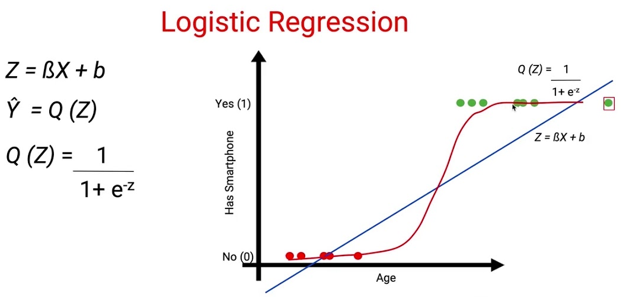

Slide 10
8. Pros
Outputs probabilities, not just classes
Easy to interpret coefficients
Computationally efficient
Works well with linearly separable data
Less prone to overfitting than complex models

Slide 11
9. Cons
Assumes linear decision boundary
Cannot capture complex non-linear relationships
Sensitive to outliers
Requires feature scaling for faster convergence
Performance drops with highly imbalanced data

Slide 12
10. Real-World Applications
Healthcare:
Disease diagnosis (Yes/No)
Patient risk prediction
Finance:
Credit default prediction
Fraud detection
Marketing:
Customer churn prediction
Ad click prediction
HR Analytics:
Employee attrition prediction
Cybersecurity:
Spam detection
Intrusion detection

Slide 13
Key Difference from Linear Regression
Aspect | Linear Regression | Logistic Regression
Output | Continuous | Probability (0–1)
Task | Regression | Classification
Function | Linear | Sigmoid
Loss | MSE | Log Loss

Slide 14
Summary
Logistic Regression is a probability-based, interpretable, and efficient classification algorithm that models the relationship between features and log-odds, making it a cornerstone technique in machine learning.

